Slide 1

safe kids
2022 - 2023
Cairo University
Faculty of Computers and Artificial intelligence
Department of Information Systems
Under the Supervision of:
Dr. Laila Abdelrahman Mohamed Esheiba
TA. Fatma Hussein

Slide 2
Outlines
01
Introduction
02
Problem Statement
03
Objective
04
Related Work
05
Proposed Work
06
App Prototype
07
Project Plan
08
Conclusion

Slide 3
1. introduction

Slide 4
introduction
Artificial Intelligence (AI) is a transformative technology with a largely positive impact on society.
AI and facial recognition technology have advanced significantly in recent years and can be applied to a range of industries, including addressing the problem of missing children.
The development and implementation of AI and facial recognition technologies have the potential to positively impact countless families and communities affected by the issue of missing children.
The use of AI and face recognition technology can significantly increase the chances of finding missing children, ultimately helping to bring them home safely.

Slide 5
2. Problem statement

Slide 6
Problem statement
According to a 2020 report by the International Centre for Missing & Exploited Children (ICMEC), Egypt is one of the top five countries in the Middle East and North Africa (MENA) region with the highest number of missing children's cases.
There are efforts to address this issue in Egypt including public awareness campaigns, specialized police units, and technology-based solutions like the Child Protection Program but they are not always enough.
Many cases are still unsolved, highlighting the need for effective and efficient solutions to help address the issue of missing children in Egypt.
Finding missing children can be difficult and time-consuming, especially when trying traditional search methods like printing, distributing flyers and posting on social media and the search area is vast or the child's whereabouts are unknown.

Slide 7
3. Objective

Slide 8
Objective
The objective of this project is to help parents find their missing kids quickly.
Why?
  We want to make it fast for people who find a lost child to reunite this child with their parents and facilitate the connection between the one who found the missing child and their families.
How?
  By creating missing children database that contains the information about them and their photos.
  And by using Face recognition technology compares the database with photos of missing kids submitted to it and can identify missing kids instantly.
The goal of the project is to ensure that most of the missing kids return to their families.

Slide 9
4. Related work

Slide 10

Related work
 | Facial Recognition | GPS Tracking | Mic. Access | Notifications | Alert | Store Information
FBI Child Id
Find My Kids
Child Rescue
Social Media
Missing Kids
Our Application
10

Slide 11
5. Proposed work

Slide 12
What We Will Talk About In This Section?
1
2
3
Application Features
Requirement Analysis
Diagrams & Architecture

Slide 13
Application Features
Register/Login
Searching for a match
Users should be registered into the application to use its features.
The user who uploaded the profile of the missing kid will receive a list of high percentage matches of missing children from the database.
Add Missing Kid / Create Kid Profile
Notification
Users can create a profile for their missing child by uploading a photo and relevant details.
The application sends notification to the user in case of a match
Add found kid
List missing kids
Users upload a photo for a kid they believe may be missing and fill the needed information
The application allows users to view a list of all missing kids .
.

Slide 14
Functional Requirements
Facial Recognition
Perform facial recognition on photos uploaded by users.
2. User Accounts
Allow users to create accounts with unique login credentials.
3. Create A Missing Kid Profile
Perform facial recognition on photos uploaded by users.
4. Add a found kid
Allow users to add a photo of a found kid.
5. Search Functionality
Search the database for a match of an uploaded photo with facial recognition.
6. Match Notification
Notify the user and the parent if there is a match of a missing kid.

Slide 15
Functional Requirements (Cont.)
Mark as found
  Allow the user to mark his kid as found in case he finds him.
Update User Profiles
  Allow users to view and update their own profiles, including personal information and contact details.
Forget Password
  Allow the user to reset his password in case he forgets it then verify the user’s identity through email.
Admin Panel
  A panel for authorized personnel to manage the database, including adding, deleting, and modifying kid profiles.
List Missing Kids
  Allow users to view a list of all missing kids that have been added to the database by other users.
View Statistics
  Allow admins or users to view statistics related to searches performed in the system, admins can choose to export the statistics to a file for further analysis.

Slide 16
Non-Functional Requirements
Performance
  Matching a photo of a missing kid quickly and accurately with a photo in the database.
Security
  Securing the database and protecting the users’ privacy, such as authorization and secure authentication methods.
Usability
  The User interface should be easy to understand and navigate.
Reliability
  The Application should be reliable, with minimal downtime and error rates.
Maintainability
  The Application should be easy to maintain, with regular updates and the ability to quickly fix any issues that may arise.
Cost
  The development and maintenance of the software should be cost-effective, with a balanced budget for technology and resources.
16

Slide 17
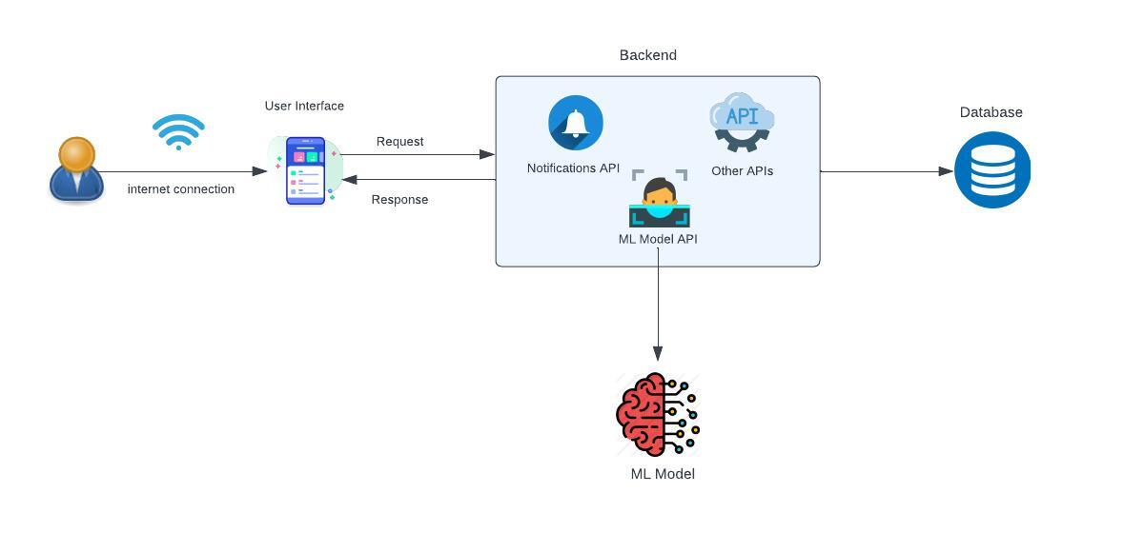
System Architecture

Slide 18
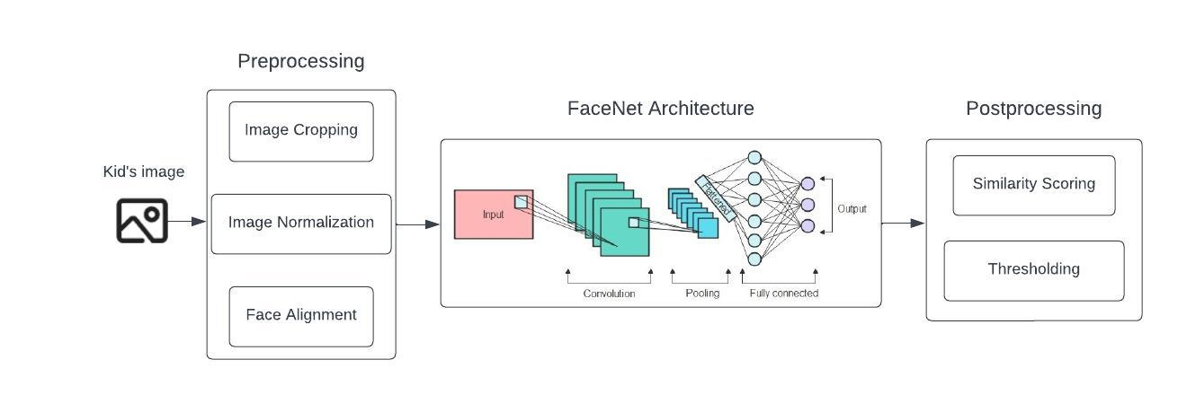
Model Architecture

Slide 19
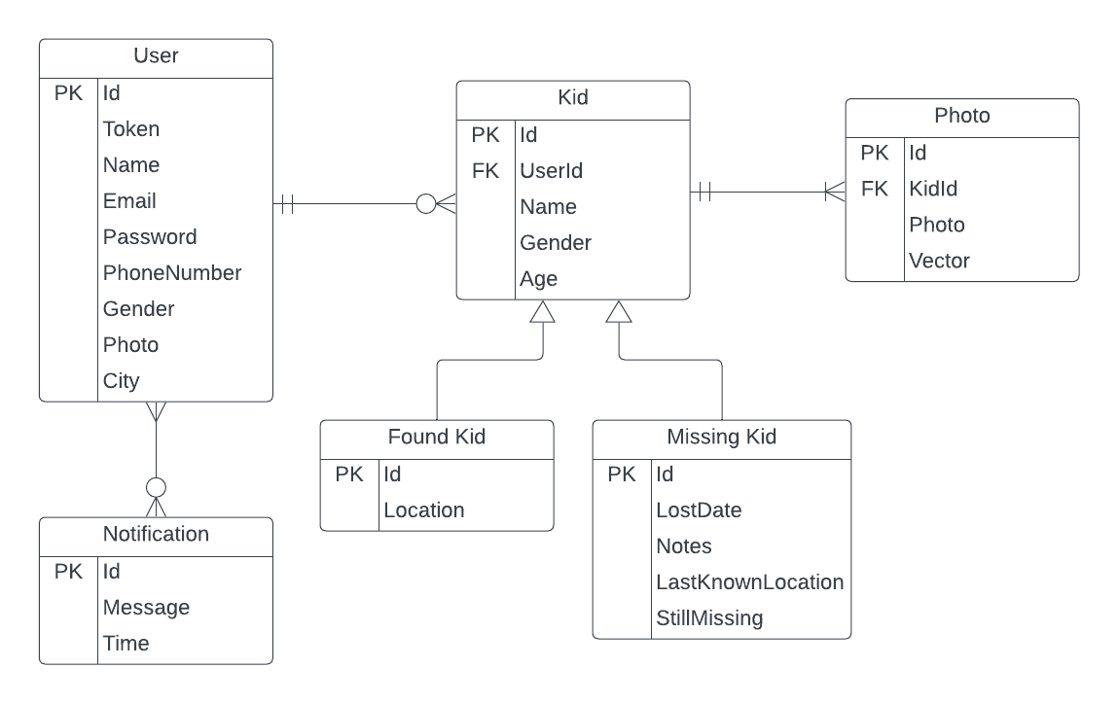
Entity Relationship Diagram (ERD)
19

Slide 20
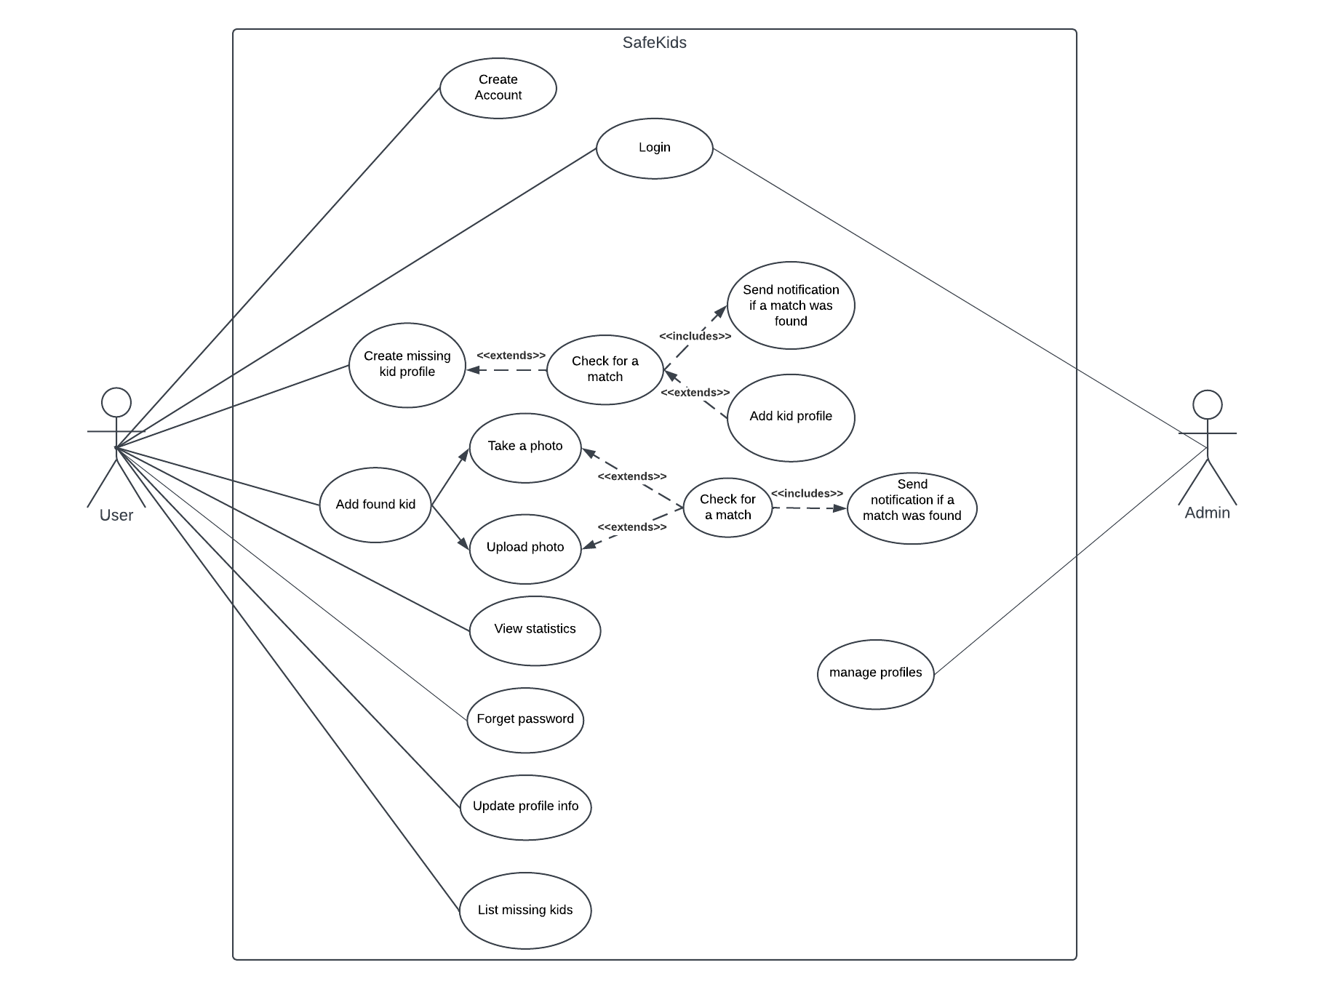
Use Case Diagram

Slide 21
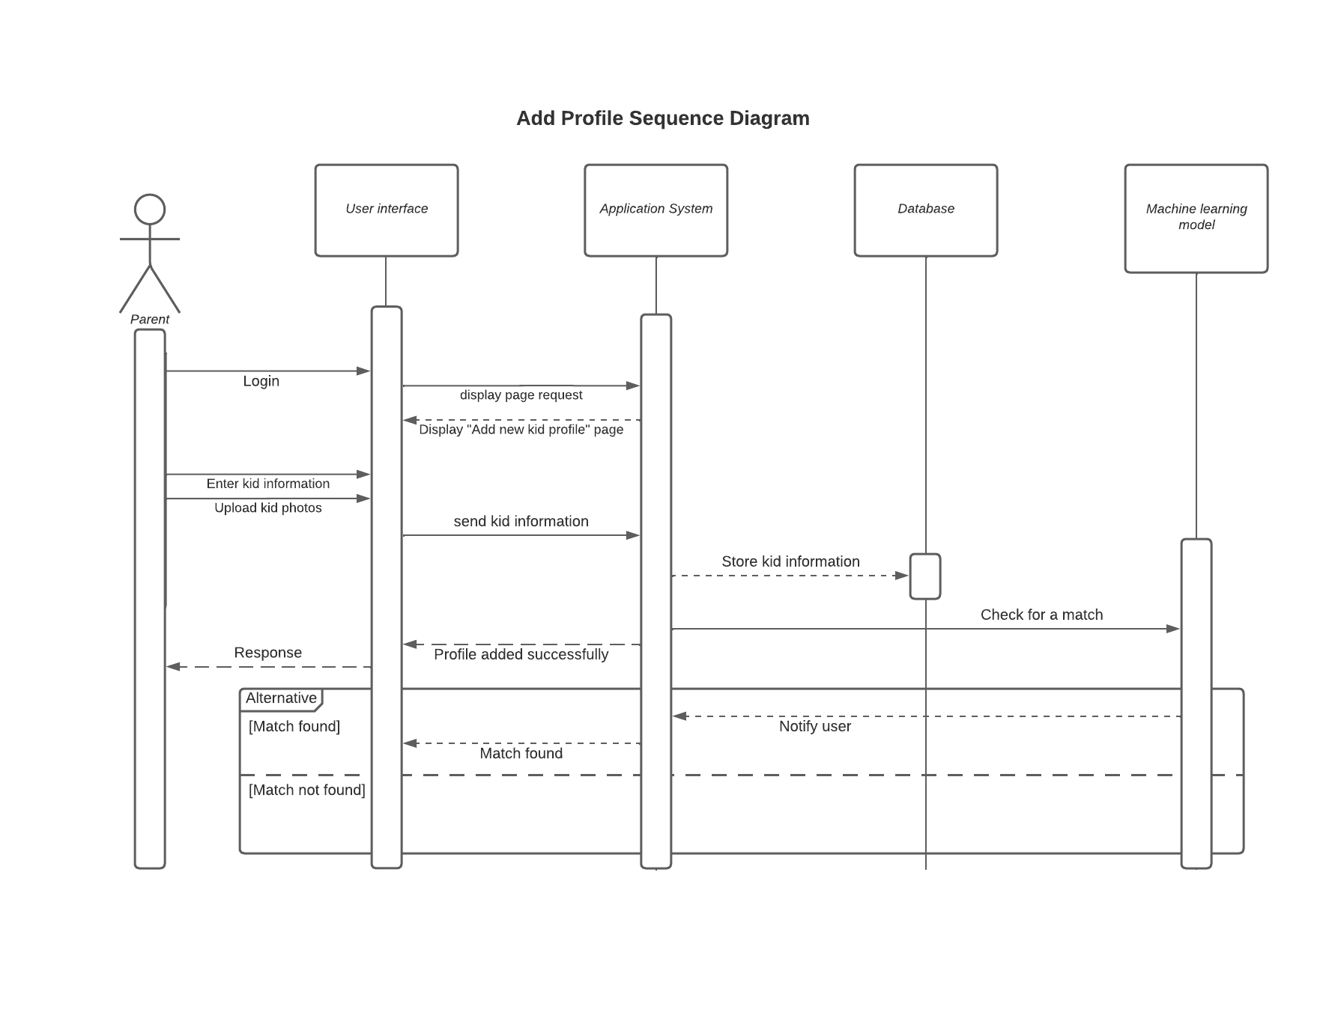
Sequence Diagram
Create a kid profile
21

Slide 22
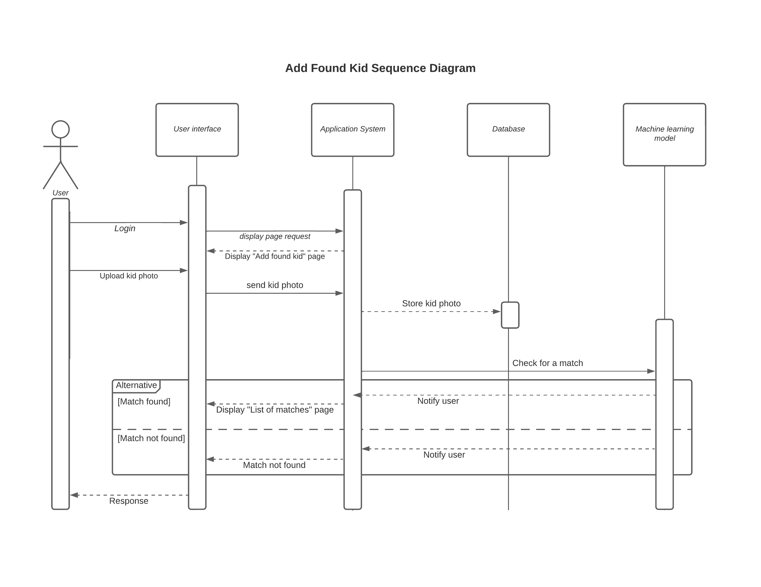
Sequence Diagram
Add a found kid
22

Slide 23
6. App prototype

Slide 24

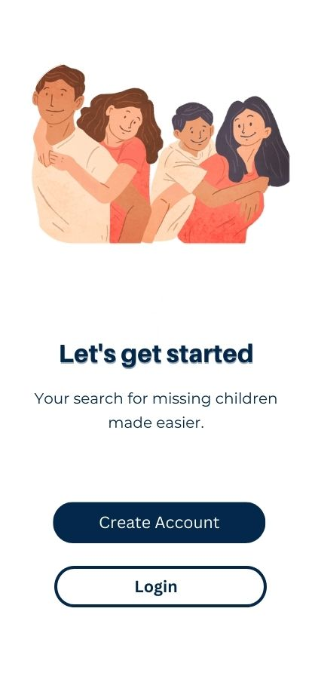
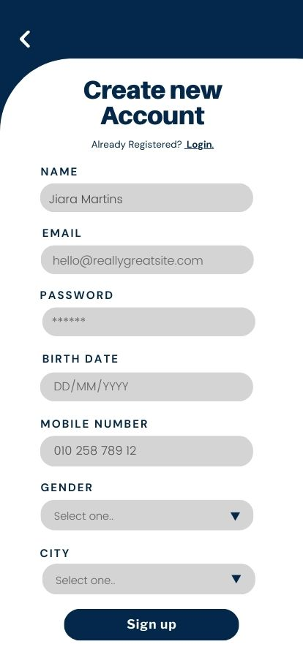

App prototype

Slide 25
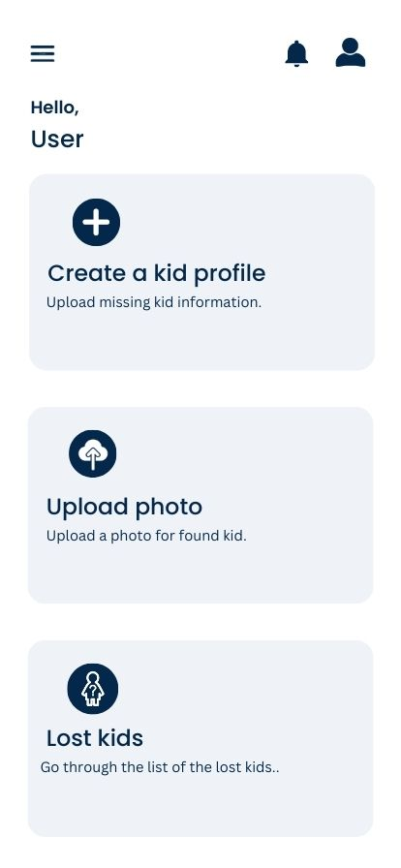
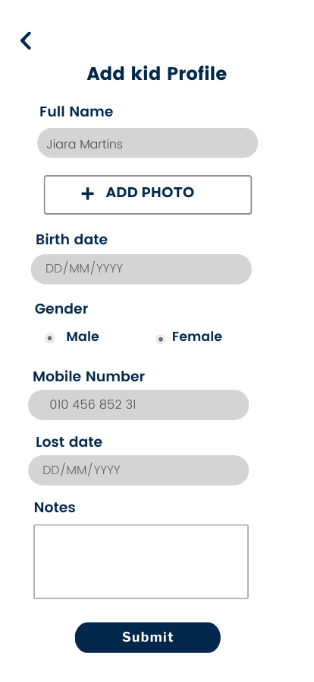
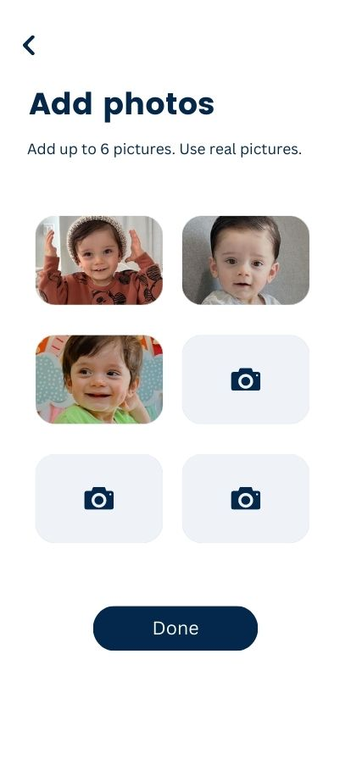
App prototype

Slide 26
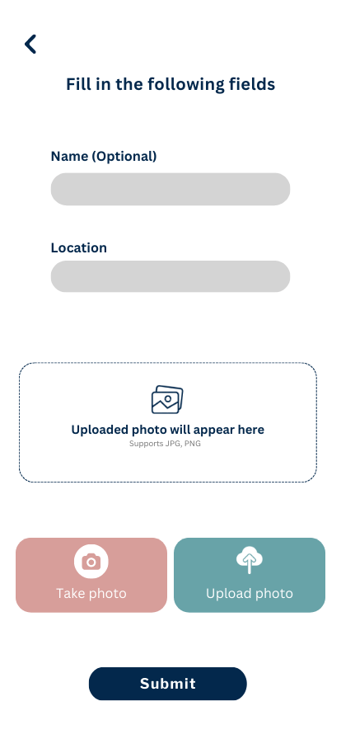

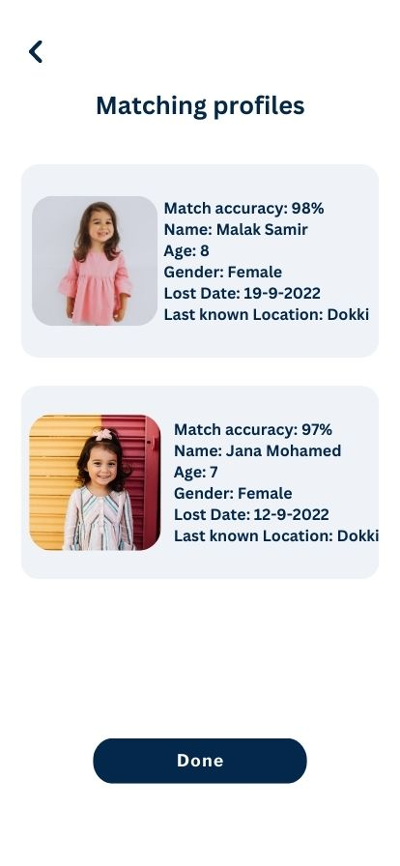
App prototype

Slide 27
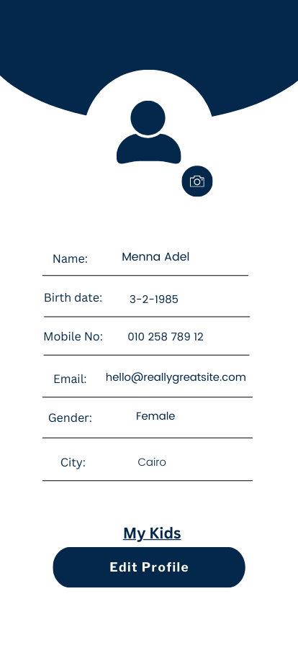
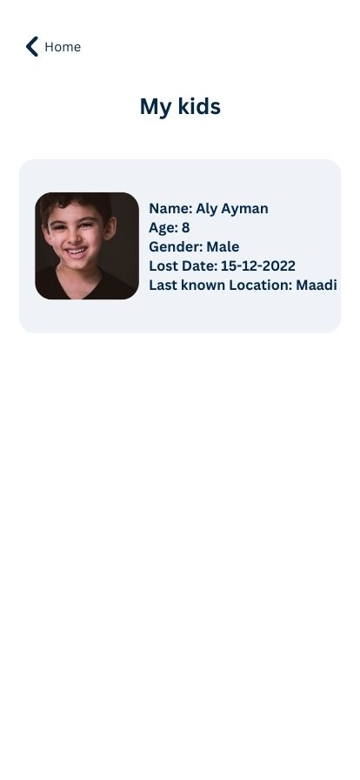
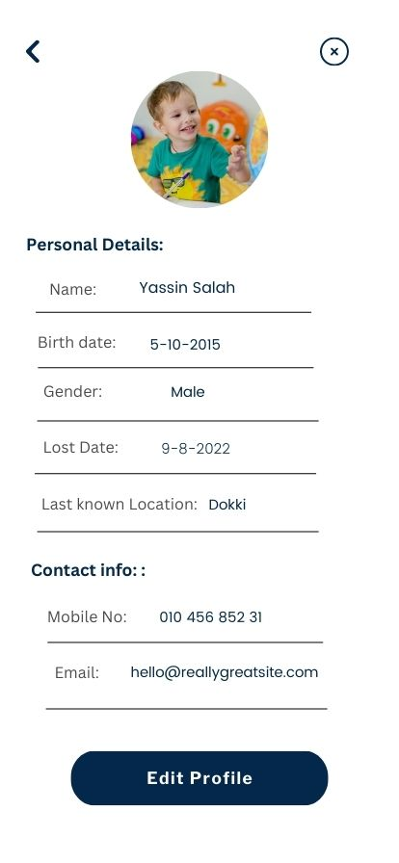
App prototype

Slide 28
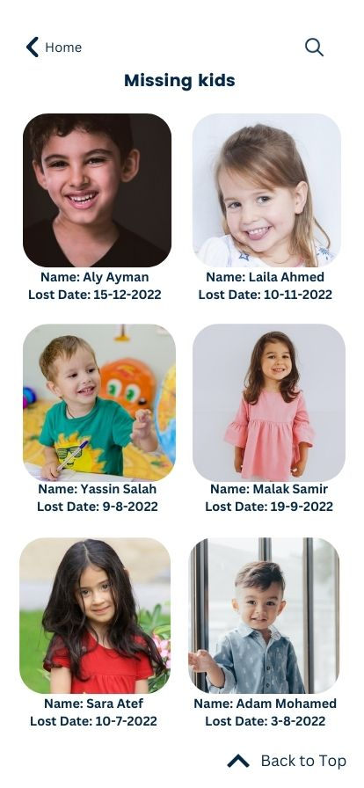
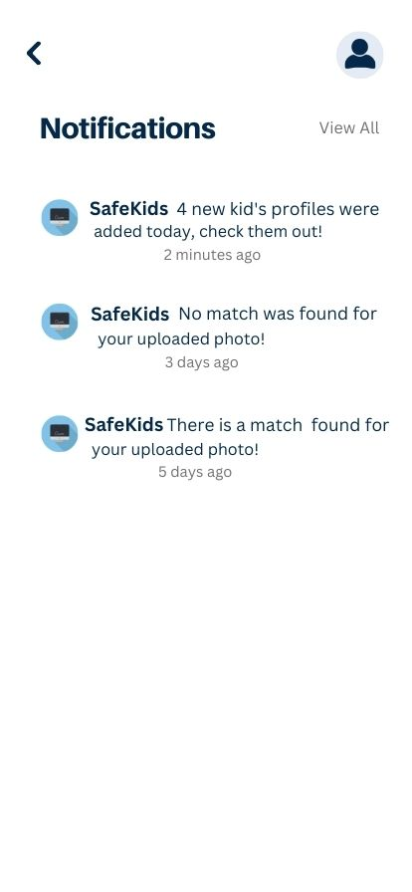
App prototype

Slide 29
7. Project plan

Slide 30
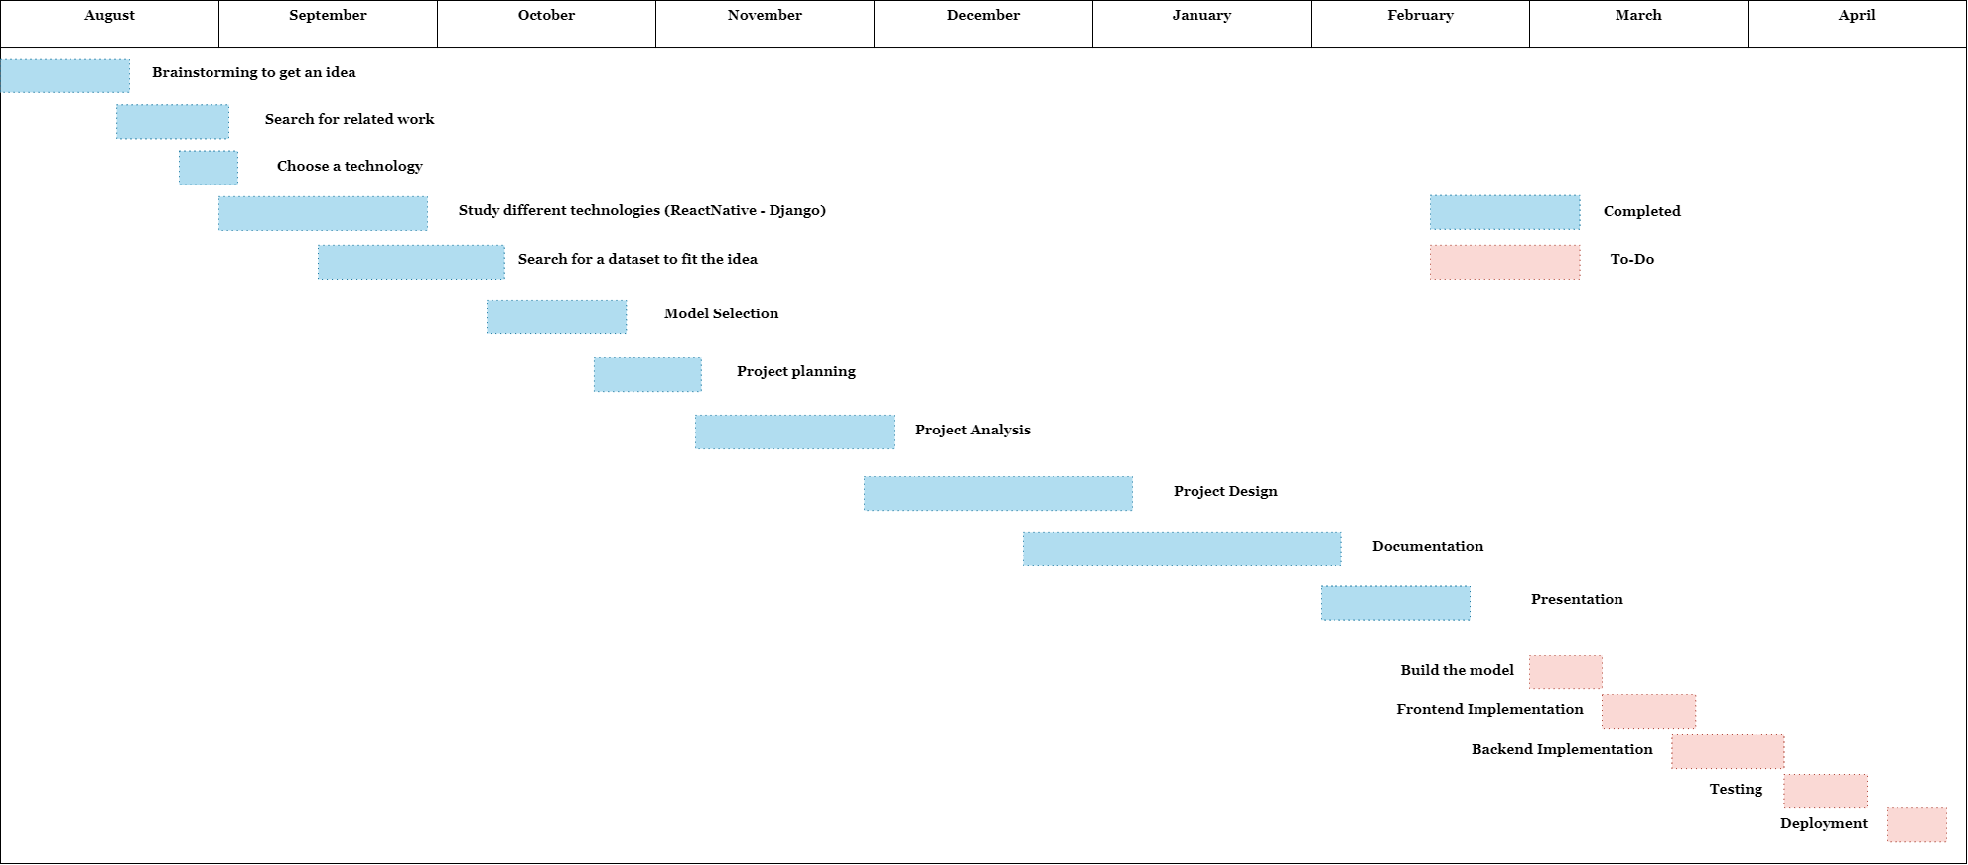
Project plan

Slide 31
8. conclusion

Slide 32
conclusion
To recap, The goal of the project is to ensure that most of the missing kids return to their families.
Our application idea is that the parent creates a profile for his missing kid, so when anyone finds the kid and uploads the photo to the app the application starts to search through facial recognition.
We're very enthusiastic to work on solving this problem especially since Egypt is one of the top five countries in the area suffering from it.

Slide 33
Presented by
Islam Sameh Ibrahim
Hams Ayman El Said
Saif Eldin Aly Mahmoud
Mennat-allah Adel Hussein
Ahmed Magdy Abdelfattah

Slide 34
THANK YOU

